Slide 1
KNN, LDA, and QDA
UIUC ECON 490: Applied Machine Learning in Economics

Slide 2
Overview
KNN
Data-driven method
No inference!
LDA/QDA
Model-driven method
No inference!

Slide 3
K-Nearest Neighbors
Data-Driven Algorithm

Slide 4

KNN for Classification
$$\text{Pr}(Y=k|X=x)=\frac{1}{K}\sum_{i∈N_{0}}^{​}{I}\{y_{i}=k\}$$
$N_{0}$ - $K$ nearest observations
Prediction:
Max $\text{Pr}(Y=k|X=x)$

Slide 5
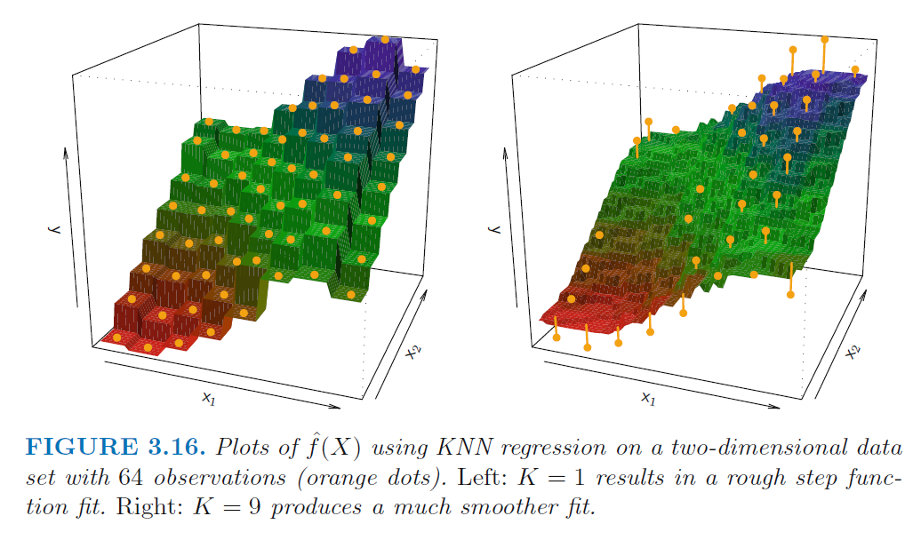

KNN for Regression
$$\hat{y}=\frac{1}{K}\sum_{i∈N_{0}}^{​}{y_{i}}$$
Nonlinear predictor

Slide 6
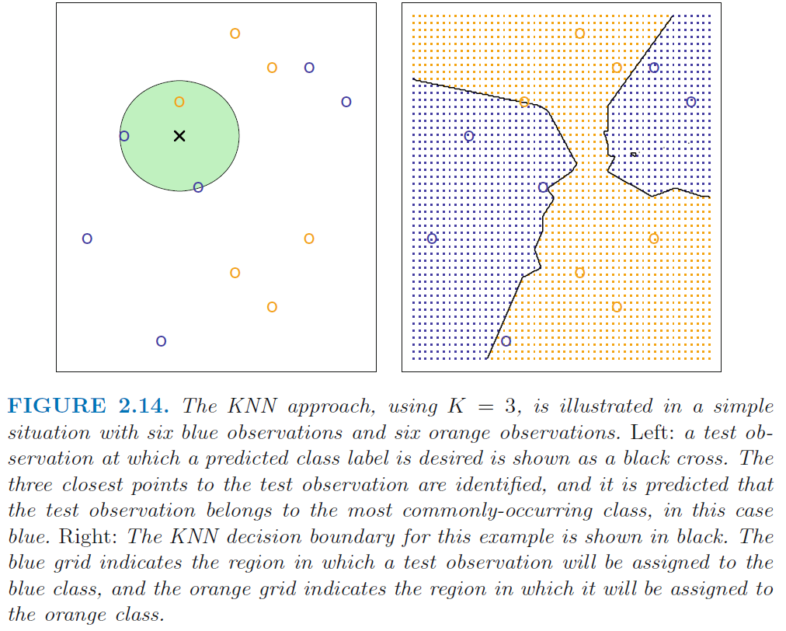
KNN Prediction

Slide 7
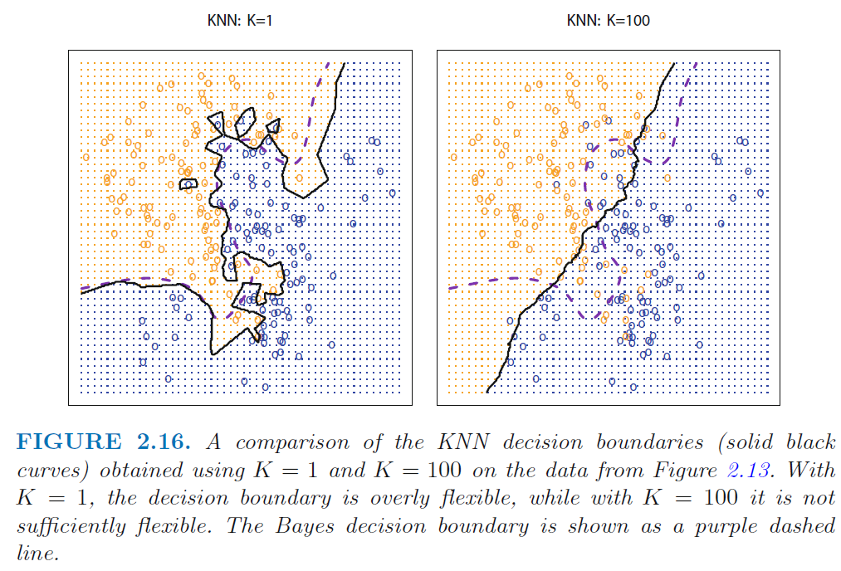
KNN Flexibility

Slide 8
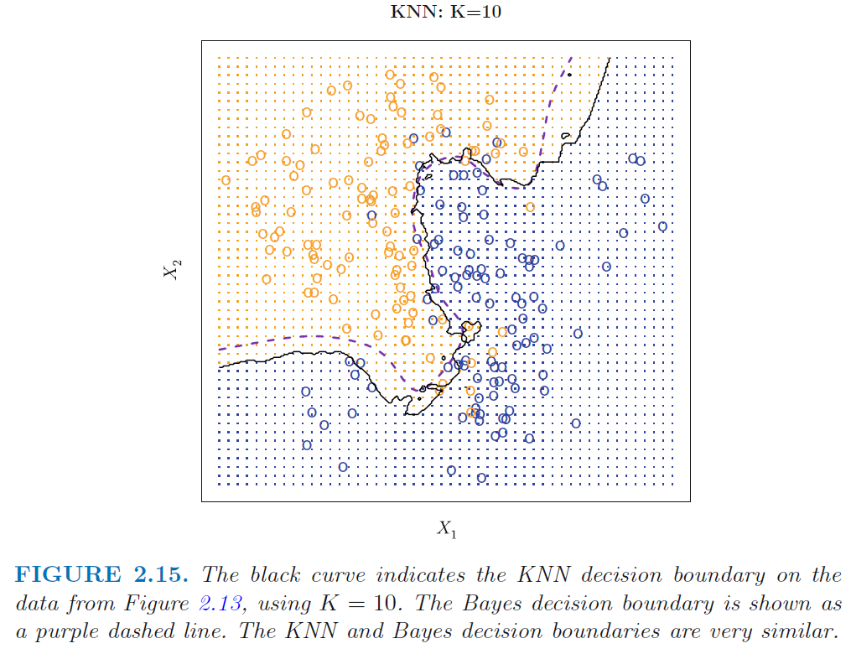
KNN Choice of K

Slide 9
Linear Discriminant Analysis
Model Driven Method

Slide 10
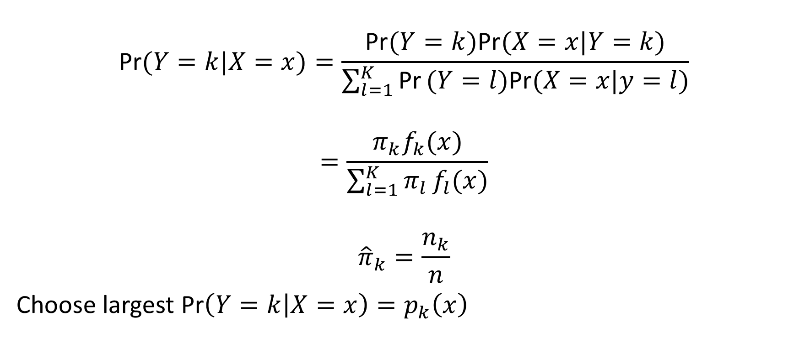
Bayes Theorem
$$\text{Pr}(Y=k|X=x)=\frac{\text{Pr}(Y=k)\text{Pr}(X=x|Y=k)}{\sum_{l=1}^{K}{\text{Pr}}(Y=l)\text{Pr}(X=x|y=l)}$$
$$=\frac{π_{k}f_{k}(x)}{\sum_{l=1}^{K}{π_{l}}f_{l}(x)}$$
$${\hat{π}}_{k}=\frac{n_{k}}{n}$$
Choose largest $\text{Pr}\left(Y=k | X=x\right)=p_{k}\left(x\right)$

Slide 11
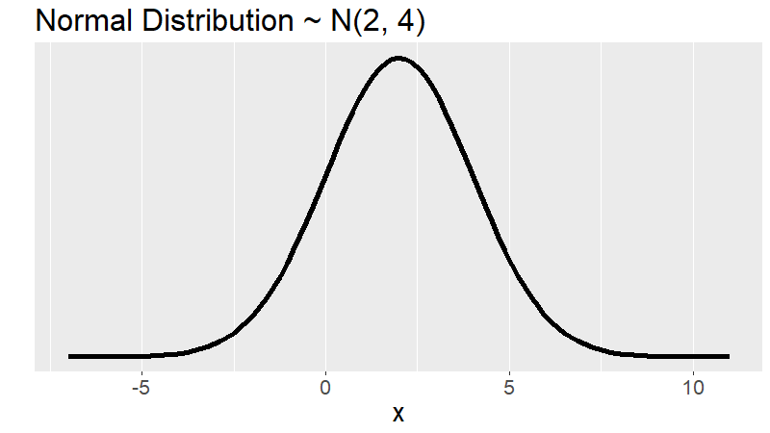
Choice of $f_{k}(x)$

Slide 12

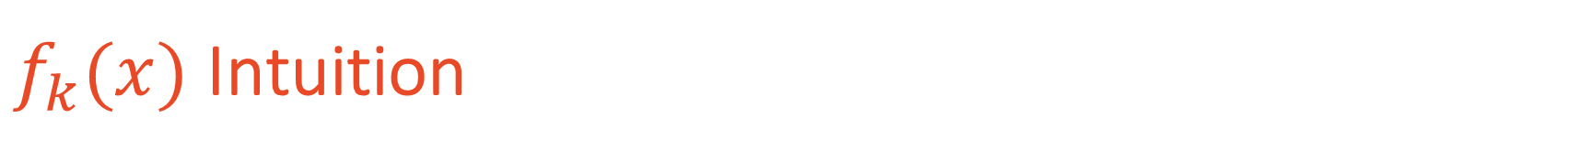
$f_{k}(x)$ Intuition
$$f_{k}\left(x\right)=\frac{1}{\sqrt{2πσ_{k}^{2}}}e^{−\frac{(x−μ_{k})^{2}}{2σ_{k}^{2}}}$$
$$(x−μ_{k})^{2}$$
LDA: $σ_{k}^{2}=σ^{2} ∀ k=1,...,K$

Slide 13
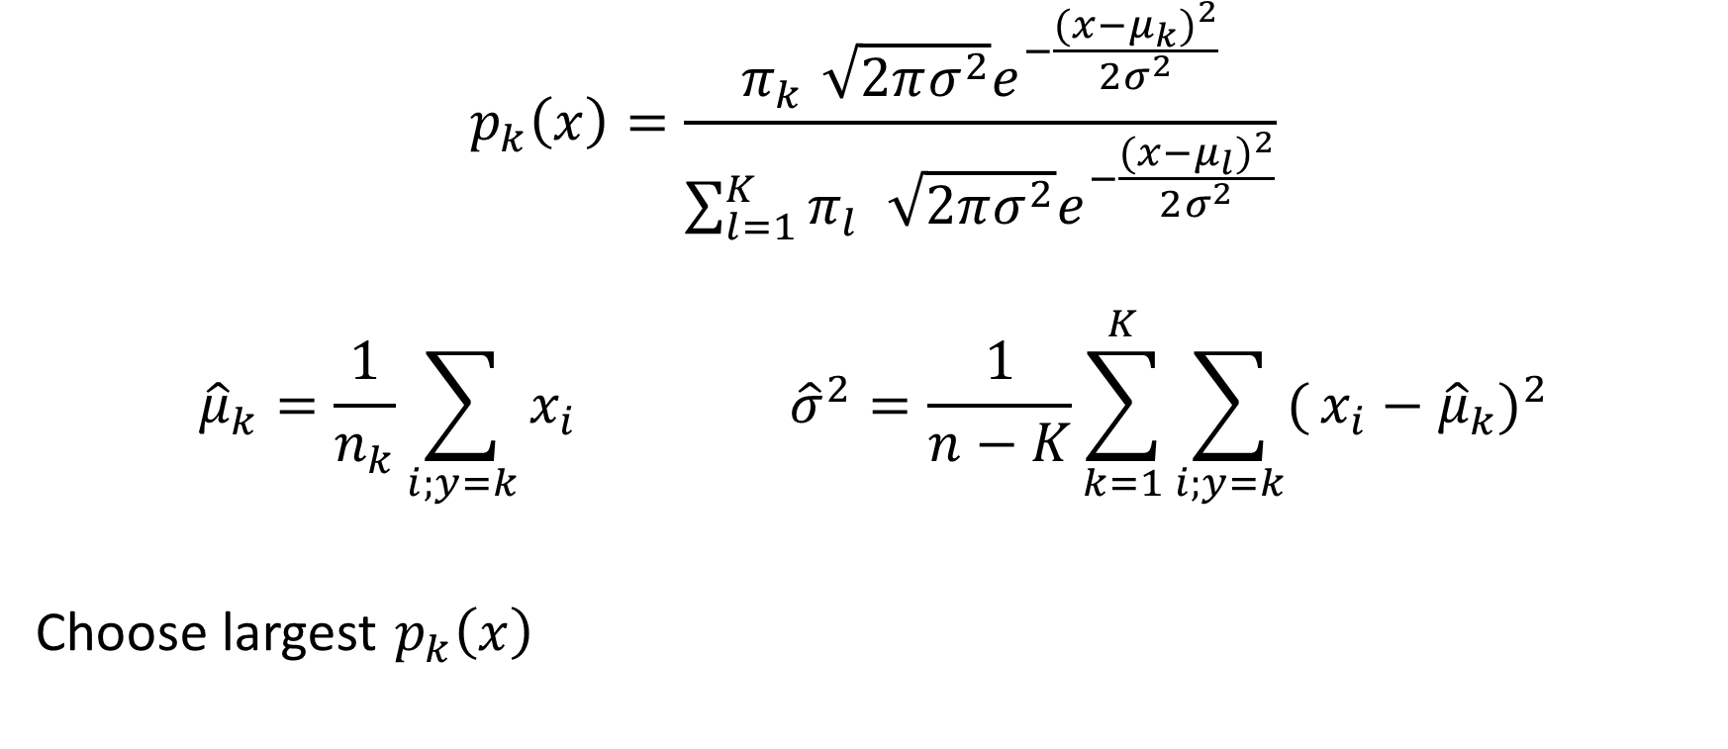
Computing Probabilities
$$p_{k}\left(x\right)=\frac{π_{k}\sqrt{2πσ^{2}}e^{−\frac{(x−μ_{k})^{2}}{2σ^{2}}}}{\sum_{l=1}^{K}{π_{l}}\sqrt{2πσ^{2}}e^{−\frac{(x−μ_{l})^{2}}{2σ^{2}}}}$$
$${\hat{μ}}_{k}=\frac{1}{n_{k}}\sum_{i;y=k}^{​}{x_{i}} {\hat{σ}}^{2}=\frac{1}{n−K}\sum_{k=1}^{K}{\sum_{i;y=k}^{​}{(}}x_{i}−{\hat{μ}}_{k})^{2}$$
Choose largest $p_{k}\left(x\right)$

Slide 14
Quadratic Discriminant Analysis
LDA’s Generalization

Slide 15

Extension to LDA
Let $σ^{2}$ vary within $k$
$${\hat{σ}}_{k}^{2}=\frac{1}{n_{k}−1}\sum_{i;y=k}^{​}{(}x_{i}−{\hat{μ}}_{k})^{2}$$
What if standardized variables? LDA or QDA?

Slide 16
Confusion Matrix and ROC
Classification Diagnostics

Slide 17
Confusion Matrix
Reference
Prediction 1 2 3
1 1022 424 95
2 532 1130 512
3 20 59 77

Slide 18
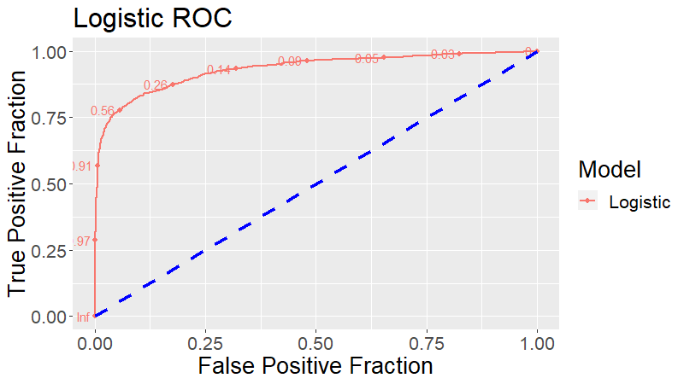
Receiver Operating Characteristc
Y = Sensitivity
(True Positive rate)
X = 1 – Specificity
(False positive rate)

Slide 19
To Do
Read
5.1
Complete
Lab 4.6

